Slide 1
Practice
9A

Slide 2
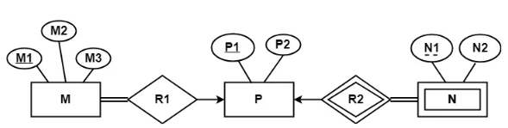
Q1.
Find the minimum number of tables required for the following ER diagram in relational model.
Ans: M R1 (M1 , M2 , M3 , P1)
P R2(P1 , P2)
N R3 (P1 , N1 , N2)

Slide 3
Q2.
Construct an E-R diagram for a car-insurance company whose customers own one or more cars each. Each car has associated with it zero to any number of recorded accidents.

Slide 4
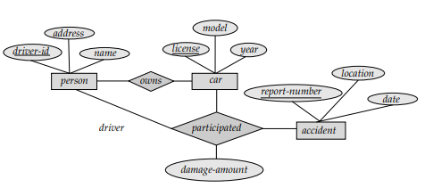
Ans. 2

Slide 5
Q3.
Construct an E-R diagram for a hospital with a set of patients and a set of medical doctors. Associate with each patient a log of the various tests and examinations conducted.

Slide 6
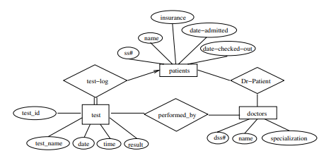
Ans. 3

Slide 7
Q4.
A university registrar’s office maintains data about the following entities: (a) courses, including number, title, credits, syllabus, and prerequisites; (b) course offerings, including course number, year, semester, section number, instructor(s), timings, and classroom; (c) students, including student-id, name, and program; and (d) instructors, including identification number, name, department, and title. Further, the enrollment of students in courses and grades awarded to students in each course they are enrolled for must be appropriately modeled. Construct an E-R diagram forthe registrar’s office. Document all assumptions that you make about the mapping constraints.

Slide 8
In the answer given here, the main entity sets are student, course, course-offering, and instructor. and instructor. The entity set course-offering is a weak entity set dependent on course. The assumptions made are :
a. a class meets only at one particular place and time. This E-R diagram cannot model a class meeting at different places at different times.
b. There is no guarantee that the database does not have two classes meeting at the same place and time.

Slide 9
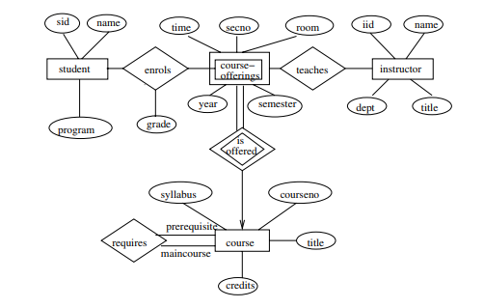
Ans.

Slide 10


